Slide 1

Fundamental of Database System
Introduction to Database System
Sirage Zeynu
Department of Computer science
College of Computing Science
Debere Berhan University
2019

Slide 2
Objectives
At the end of the lesson students should be able to:
Understand the database system
Understand the concept of Database system and File System
Understand Characteristics of the Database Approach
Understand Actors on the Scene Functions of DBMS
Understand Data models and conceptual models
Understand Database Languages (DDL, DML,DCL)

Slide 3
Contents
Introduction to database system
Database system and File System
Characteristics of the Database Approach
Actors on the Scene Functions of DBMS
Data models and conceptual models
Database Languages (DDL, DML)

Slide 4
Introduction to Database System
Database is a collection of related data.
data is a collection of facts and figures that can be processed to produce information.
Mostly data represents recordable facts.
Data aids in producing information, which is based on facts.
For example, if we have data about marks obtained by all students, we can then conclude about toppers and average marks.
Information : when data is processed and converted into a meaningful and Useful form, it is known as Information.
Information is nothing but refined data
Well organized data
Information is data that have been put in to a meaningful & Useful context.

Slide 5
Introduction to Database System
Database is a collection of related data.
A database has the following implicit properties:
A database represents some aspect of the real world, sometimes called the mini world or the universe of discourse (UoD).
A database is a logically coherent collection of data with some inherent meaning.
A random assortment of data cannot correctly be referred to as a database.
A database is designed, built, and populated with data for a specific purpose.
It has an intended group of users and some preconceived applications in which these users are interested.

Slide 6
Database management system (DBMS)
A DBMS is a collection of programs that enables users to create and maintain a database.
A DBMS is a software package designed to store and manage databases.
The DBMS is a general-purpose software system that facilitates the processes of defining, constructing, manipulating, and sharing databases among various users and applications.
The database definition or descriptive information is also stored by the DBMS in the form of a database catalog or dictionary; it is called meta-data.
Constructing the database is the process of storing the data on some storage medium that is controlled by the DBMS.
Manipulating a database includes functions such as querying the database to retrieve specific data, updating the database to reflect changes in the mini world, and generating reports from the data.
Sharing a database allows multiple users and programs to access the database simultaneously.
Notes:
An Example
Let us consider a simple example that most readers may be familiar with: a UNIVERSITY database for maintaining information concerning students, courses, and grades in a university environment. The database is organized as five files, each of which stores data records of the same type.3 The STUDENT file stores data on each student, the COURSE file stores data on each course, the SECTION file stores data on each section of a course, the GRADE_REPORT file stores the grades that students receive in the various sections they have completed, and the PREREQUISITE file stores the prerequisites of each course.

Slide 7
DBMS Software>>Example
MySQL Database
MS- Access Oracle Database
Microsoft SQL Server
File Maker
NoSQL
Postgresql
MS Fox Pro
DB2

Slide 8
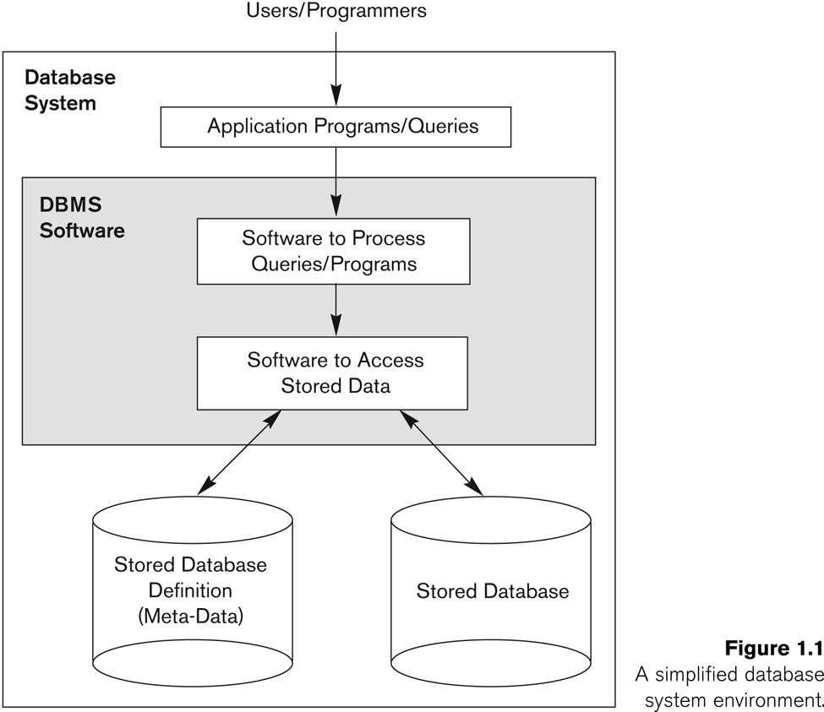
Database management system (DBMS)>>Environment
Credit

Slide 9
Characteristics of the Database Approach
A modern DBMS has the following characteristics:
Real-world entity: A modern DBMS is more realistic and uses real-world entities to design its architecture. It uses the behavior and attributes too. For example, a school database may use students as an entity and their age as an attribute.
Relation-based tables: DBMS allows entities and relations among them to form tables
Isolation of data and application: A database system is entirely different than its data. A database is an active entity, whereas data is said to be passive, on which the database works and organizes.
Less redundancy: DBMS follows the rules of normalization, which splits a relation when any of its attributes is having redundancy in values.
Consistency: Consistency is a state where every relation in a database remains consistent. There exist methods and techniques, which can detect attempt of leaving database in inconsistent state.
Query Language: DBMS is equipped with query language, which makes it more efficient to retrieve and manipulate data

Slide 10
Characteristics of the Database Approach
ACID Properties: DBMS follows the concepts of Atomicity, Consistency, Isolation, and Durability These concepts are applied on transactions, which manipulate data in a database.
Multiuser and Concurrent Access: DBMS supports multi-user environment and allows them to access and manipulate data in parallel
Multiple views: DBMS offers multiple views for different users.
Security: DBMS offers methods to impose constraints while entering data into the database and retrieving the same at a later stage. DBMS offers many different levels of security features, which enables multiple users to have different views with different features.

Slide 11
Database system and File System
What is File System?
A file system handles the way of reading and writing data to the hard disk.
The file system is installed into the computer with the operating system.
Operating systems such as Windows and Linux have their own file system.
New Technology File System (NTFS) is the Windows file system. Extended File System (Ext) is the Linux file system.
A file such as text file goes through the file system to store into the hard disk. Similarly, the file is read via the file system.
Usually, there is a possibility of data redundancy in a file system because there can be duplicate data.

Slide 12
Database system Vs File System

Slide 13
Actors on the Scene
in large organizations, many people are involved in the design, use, and maintenance of a large database with hundreds of users.
identify the people whose jobs involve the day-to-day use of a large database; we call them the actors on the scene.
1. Database Administrators
chief administrator to oversee and manage these resources.
Responsible for authorizing access to the database, coordinating and monitoring its use, and acquiring software and hardware resources as needed.
2. Database Designers
Database designers are responsible for identifying the data to be stored in the database and for choosing appropriate structures to represent and store this data.
undertaken before the database is actually implemented and populated with data.

Slide 14
Actors on the Scene
3. End Users
End users are the people whose jobs require access to the database for querying, updating, and generating reports; the There are several categories of end users:
Casual end users
users who access the database occasionally.
Need different information from the database each time.
Use sophisticated database queries to satisfy their needs.
Are most of the time middle to high level managers.
Naive or parametric end users
Sizable/large proportion of users
Only access the database based on their access level and demand
Use standard and pre-specified types of queries.
Sophisticated end users
Are users familiar with the structure of the Database and facilities of the DBMS.
Are most of the time engineers, scientists, business analysts, etc
Have higher level queries

Slide 15
Actors on the Scene
canned transactions
Standalone users
4. System Analysts and Application Programmers (Software Engineers)
be familiar with the full range of capabilities provided by the DBMS to accomplish their tasks.

Slide 16
Database models
Database Model is a set of concepts to describe the structure of a database, and certain constraints that the database should obey.
It is a description of the way that data is stored in a database. Data model helps to understand the relationship between entities and to create the most effective structure to hold data.
Types of database models are:
1. The Hierarchical Data Model
2. The Network Data Model
3. The Relational Data Model

Slide 17
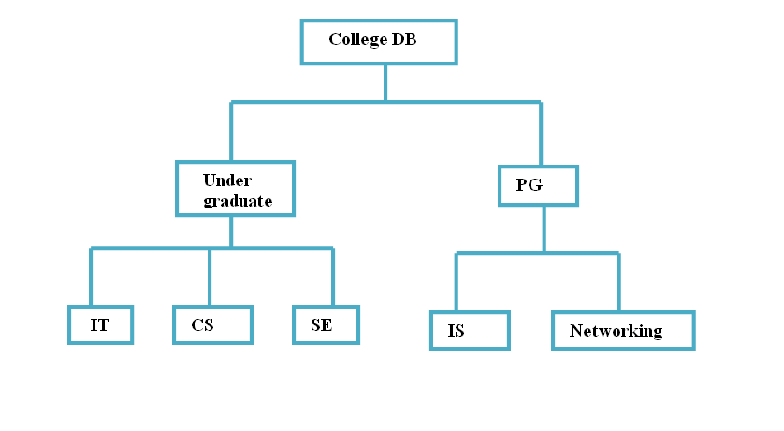
Hierarchical Database Model
This is the oldest form of database. This data model organizes the data in the tree structure i.e each child node can have only one parent node and at the top of the structure, there is a single parenthesis node.
In this model a database record is a tree that consists of one or more groupings of fields called segments, which makeup the individual nodes of the tree.
This model use one-to-many relationship.

Slide 18
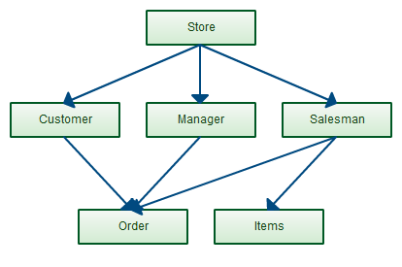
Network model
Replaces the hierarchical tree with graph thus allowing more general connections among the nodes.
Supports multiple paths in the data structure eliminates some of the drawbacks of the hierarchical model
allows one-to-one, one-to-many and many-to-many relationships
Created to:
Represent complex data relationships more effectively
Improve database performance

Slide 19
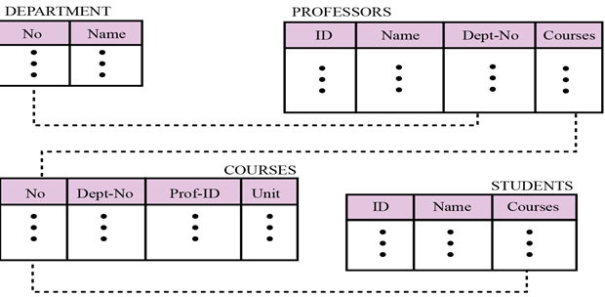
Relational Database Model
The relational database model allows the definition of data structures, storage and retrieval operations and integrity constraints.
In such a database the data and relations between them are organized in tables.
A table is a collection of records and each record in a table contains the same fields organized in columns.
The records in the table form the rows of the table.
Provides flexibility that allows changes to the database structure to be easily accommodated. It facilitates multiple views of the same database for different users.

Slide 20
The Three-Schema Architecture
The goal of the three-schema architecture is to separate the user applications from the physical database.
In this architecture, schemas can be defined at the following three levels.
The internal level
The conceptual level
The external or view level

Slide 21
The internal level
The internal level has an internal schema, which describes the physical storage structure of the database.
The internal schema uses a physical data model
describes the complete details of data storage and access paths for the database.

Slide 22
The conceptual level
The conceptual level has a conceptual schema, which describes the structure of the whole database for a community of users.
The conceptual schema hides the details of physical storage structures and concentrates on describing
entities, data types, relationships, user operations, and constraints.
Usually, a representational data model is used to describe the conceptual schema when a database system is implemented.

Slide 23
The external or view level
The external or view level includes a number of external schemas or user views.
Each external schema describes the part of the database that a particular user group is interested in and hides the rest of the database from that user group.
As in the previous level, each external schema is typically implemented using a representational data model, possibly based on an external schema design in a high-level data model.

Slide 24
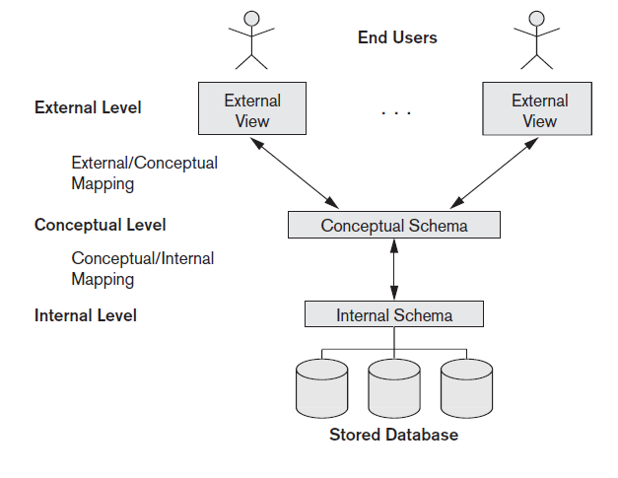
The three-schema architecture.

Slide 25
DBMS INTERFACES
Menu-based interfaces for Web clients or browsing
Forms-based interfaces
Graphical user interfaces
Natural language interfaces
Speech input and output
Interfaces for parametric users
Interfaces for the DBA

Slide 26
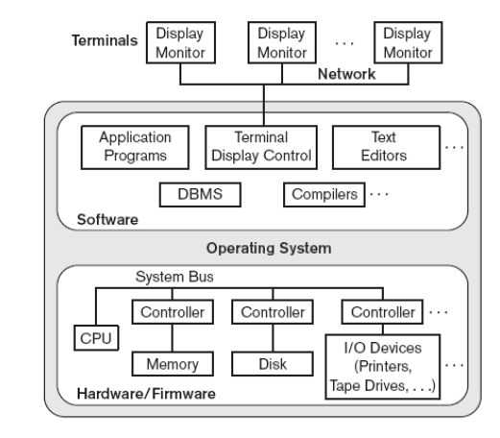
CENTRALIZED DBMS ARCHITECTURE
All DBMS functionality, application program execution, and user interface processing carried out on one machine

Slide 27
BASIC CLIENT/SERVER ARCHITECTURES
Servers with specific functionalities
File server
Maintains the files of the client machines.
Printer server
Connected to various printers; all print requests by the clients are forwarded to this machine
Web servers or e-mail servers
Client machines
Provide user with:
Appropriate interfaces to use these services
Local processing power to run local applications
DBMS example
Server handles query, update, and transaction functionality
Client handles user interface programs and application programs

Slide 28
CLIENT/SERVER DBMS SOFTWARE
Open Database Connectivity (ODBC)
Provides application programming interface (API) for C and C++
Call Level Interface (CLI)
Allows client-side programs to call the DBMS
Both client and server machines must have the necessary software installed
JDBC
Allows Java client programs to access one or more DBMSs through a standard interface
Alternative: Microsoft’s ADO.NET

Slide 29
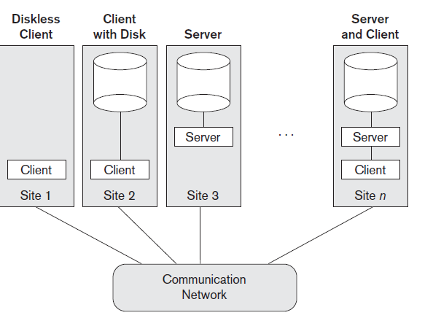
Two-Tier Client/Server Architectures for DBMSs
The architectures described here are called two-tier architectures because the software components are distributed over two systems: client and server.
The advantages of this architecture are its simplicity and seamless compatibility with existing systems.

Slide 30
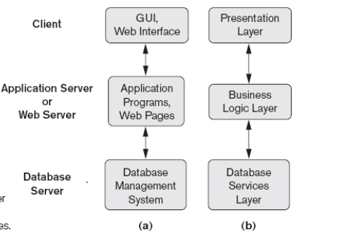
3-TIER CLIENT-SERVER DBMS ARCHITECTURE
Code partitioned between clients (user interfaces), application server, and DBMS modules

Slide 31
Components of DBMS Languages
Data manipulation language(DML):
SELECT – select records from a table
INSERT – insert new records
UPDATE – update/Modify existing records
DELETE – delete existing records
Data definition language(DDL)
CREATE – create a new Table, database, schema
ALTER – alter existing table, column description
DROP – delete existing objects from database
Data dictionary (DD): Stores definitions of data elements and data characteristics
DCL (Data Control Language): DCL mostly concerned with rights, permissions and other controls of the database system includes commands such as GRANT & REVOKE
GRANT – allows users to read/write on certain database objects
REVOKE – keeps users from read/write permission on database objects

Slide 32
Advantages of DBMS
Controlling Redundancy: because the data is stored in a set of related tables, data items do not need to be duplicated in multiple locations.
Better Security: the DBA defines authorization procedures to ensure that only legitimate users can access the database and can allow different users to have different levels of access
Increased programmer productivity: programmers do not have to create the underlining file structure for the database, so they can concentrate on logical design
Data Independence: systems that interact with a DBMS are relatively independent of how the physical data is maintained
Restricting Unauthorized Access: When multiple users share a large database, it is likely that most users will not be authorized to access all information in the database.

Slide 33
Advantages of DBMS
Stronger Standards: effective database administration helps ensure that standards for data names, formats, and documentation are followed uniformly throughout the organization
Enterprise-wide application-database administrator(DBA): (DBA) typically manages a database management system (DBMS). The DBA assesses overall requirements and maintains the database for the benefit of the entire organization rather than a single department or user.
Flexible data sharing: Data can be shared across the enterprise, allowing more users to view the same information in different ways
Better support for client/server systems: In a client/server system, processing is distributed throughout an organization. Client/server systems require the power and flexibility of database design.
Scalability: Scalability means that a system can be expanded, modified, or downsized easily to meet the rapidly changing needs of a business enterprise. Also known as extensibility.
Providing Storage Structures and Search Techniques for Efficient Query Processing
Providing Backup and Recovery: A DBMS must provide facilities for recovering from hardware or software failures.

Slide 34
Disadvantages of DBMS
High Cost of DBMS:A DBMS is a large and sophisticated piece of software ,it is expensive to purchase or lease.
Higher hardware cost: Additional memory and processing power may be required to run the DBMS, resulting in need to upgrade hardware.
Higher programming cost: A DBMS is complex tool with many features ,programmer’s should have thorough knowledge to use the system, for this organization has to pay extra for expertise.
High conversion cost: different formats are used in files, when an organization converts to a database system, data has to be removed from files and loads into the database, this may be difficult and time consuming.
Increased vulnerability: As we know that in DBMS, all the files are stored in single database so chances of database failure become more. Any accidental failure of component may cause loss of valuable data

Slide 35
More information on
Ramez Elmasri, Shamkant B. Navathe , Fundamentals of Database Systems( 6thed ) , USA, Addison-Wesley, 2011.
http://www.tutorialspoint.com

Slide 36


Slide 37
QUIZ
What are the responsibilities of the Database administrator and the database designers?
What are the different Components of DBMS Languages? Discuss the main activities of each.
What are the three types of database models? Discuss with diagram.
Discuss the differences between database systems and traditional file systems?
Write at least 5 advantage of DBMS?

